Slide 1
Discrete Mathematics - Induction

Slide 2
Well Ordering Principle
Axiom: Every non-empty set has a least element.
We consider Axioms as true statements which require no proofs.
We use this Well Ordering Principle to help us prove by Induction
There are two types we consider: weak and strong Induction.

Slide 3
Steps to Prove by Induction
Every Set has a least element.
Apply the Predicate to this least element and make sure this is true.
Like the first step in a ladder. without the first step, you can't climb using other steps.
This is the : Base Case.
The Second step is: Inductive Step.
Show P ( k ) 🡪 P ( k + 1 )
Here you Assume P ( k ) true. This is Inductive Hypothesis
And Using the Inductive Hypothesis, prove P ( k+1) to be true for any values of k .

Slide 4
Induction
Base Step: P is true for some initial value
Inductive Step : If P is true for k, for some k, then P ( k+1) is true too.
P(k) 🡪 P( k + 1)

Slide 5
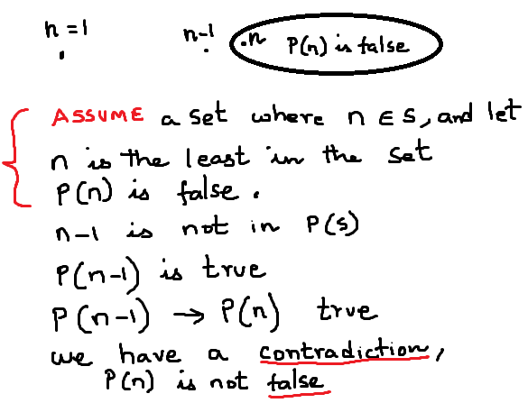
Using Well Ordering Principle to Validate Proof by Induction

Slide 6
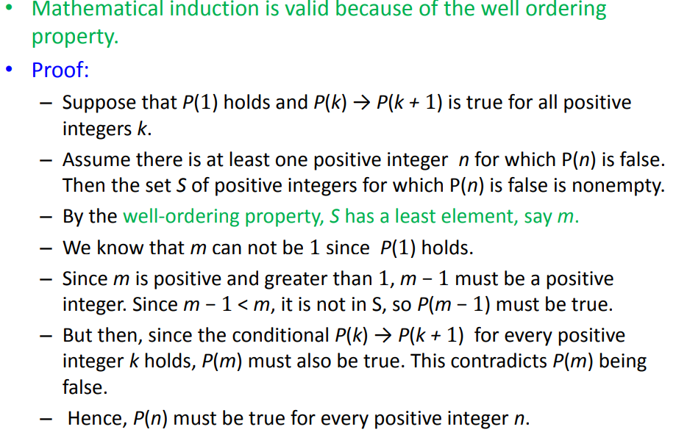

Slide 7
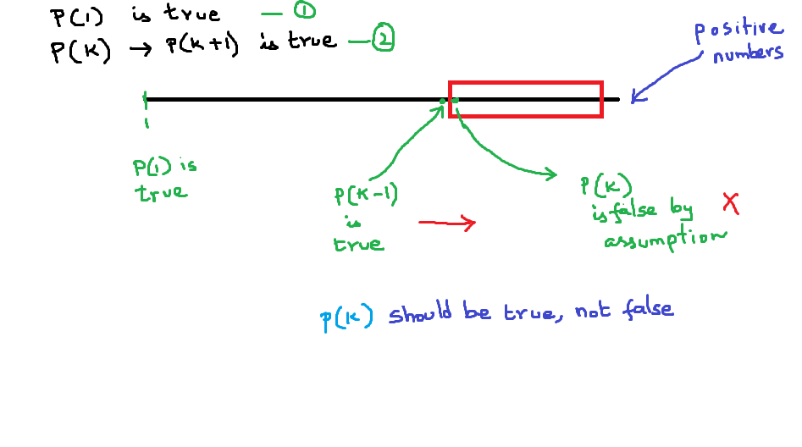
Well ordering principle

Slide 8
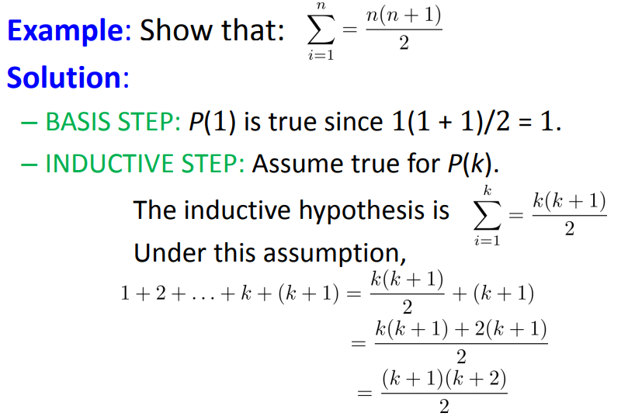
Problem-1

Slide 9
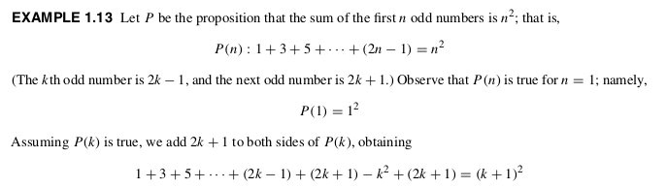
Problem 2

Slide 10
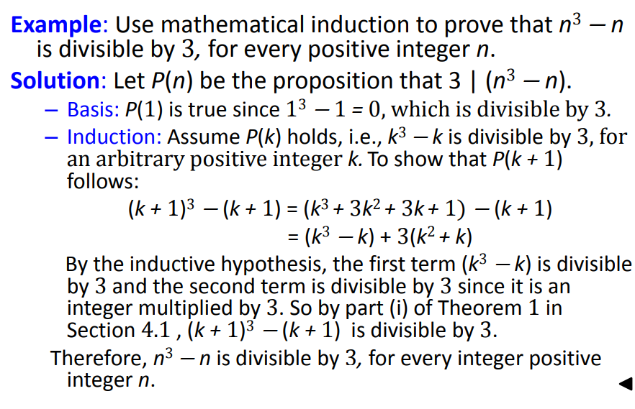
Problem 3

Slide 11
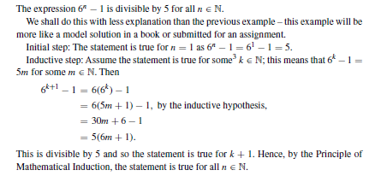
Problem 4

Slide 12
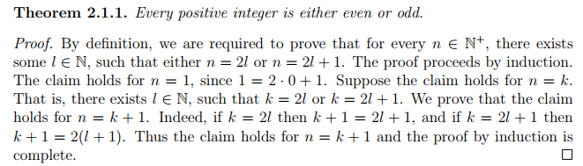
Problem 5

Slide 13
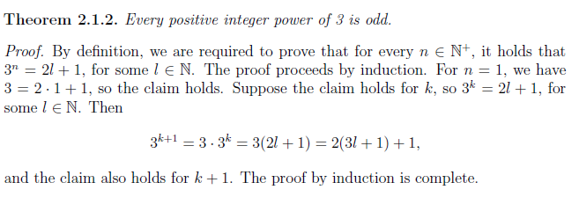
Problem 6

